Slide 1

BREAST CANCER PROFILING

Slide 2
BREAST CANCER PROFILING
“AKA HOW TO MAKE A STUDY
NEARLY IMPOSSIBLE TO REPRODUCE”

Slide 3
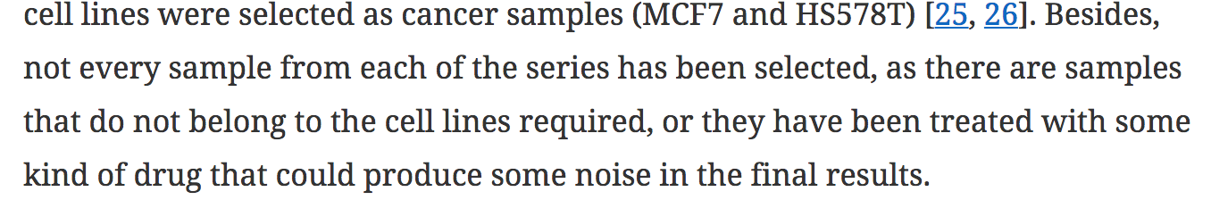
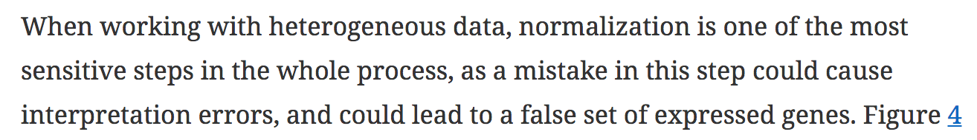
NOTABLE QUOTES
X
Availability of data and materials
All data generated or analyzed during this study are included in this published article and its supplementary information files.
X
X

Slide 4
 | Platform | Technology | samples used vs Total samples in project | Excluded outliers | Samples origin
TRAINING SERIES
GSE52712 | Affymetrix | Microarray | 19 (20) | 1 | Manchester (UK)
GSE40987 | Affymetrix | Microarray | 10 (10) | 0 | Boston (USA)
GSE52262 | Affymetrix | Microarray | 16 (**27; ?) | 0 | Houston (USA)
GSE12790 | Affymetrix | Microarray | 20 (**98; 17 are MCF10A, 1 is MCF7) | 1 | San Francisco (USA)
GSE46834 | Illumina | Microarray | 8 (8) | 0 | New York (USA)
GSE68651 | Illumina | Microarray | 35 (36) | 1 | Southampton (UK)
GSE74251 | Illumina | RNA-Seq | 12 (**6 are YB5 colon cancer cells) | 0 | Philadelphia (USA)
GSE74377 | Illumina | RNA-Seq | 12 (**16; ?) | 0 | Iowa (USA)
TEST SERIES
GSE78011 | Illumina | RNA-Seq | 3 (**10; 3 are controls?) | 0 | Louisville (USA)
GSE81593 | Illumina | RNA-Seq | 3 (**12; ?) | 0 | New York (USA)
GSE75292 | Illumina | Microarray | 6 (6) | 1 | Goyang (South Korea)
GSE29327 | Affymetrix | Microarray | 6 (6) | 0 | South San Francisco (USA)
GSE30931 | Illumina | Microarray | 12 (12) | 0 | Goettingen (Germany)
GSE48398 | Illumina | Microarray | 36 (36) | 0 | Texas (USA)
GSE35928 | Affymetrix | Microarray | 6 (6) | 0 | Piscataway (USA)
GSE57339 | Illumina | Microarray | 12 (12) | 0 | New Haven (USA)
GSE45715 | Illumina | Microarray | 42 (**53; 42 are MCF7, 11 are MCF10A) | 0 | Miami (USA)

Slide 5
WORKFLOWS
Perl script to grab SRR accessions
Align with HiSat2
Count with Subread
(featureCount)
Normalization and differential gene expression with DESEQ2

Slide 6
HEAT MAPS

Slide 7
PCA BATCH EFFECTS

Slide 8
BATCH EFFECTS

Slide 9
GENE CLASSIFIERS OF BREAST CANCER

Slide 10
